Slide 1
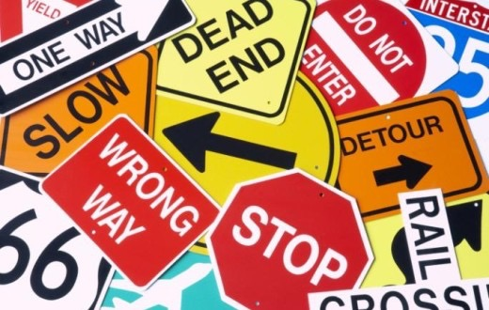

Slide 8
QUIZ

Slide 13
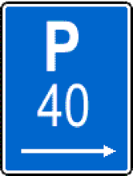

Slide 17
