Slide 1
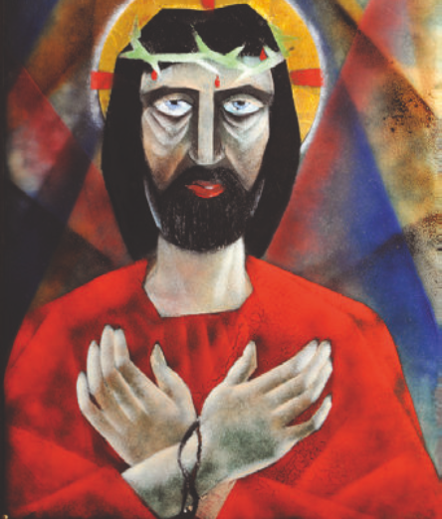
The first station Jesus is condemned to death

Slide 2
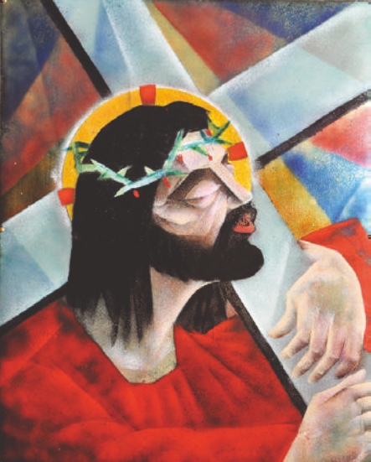
The second station Jesus carries the cross

Slide 3
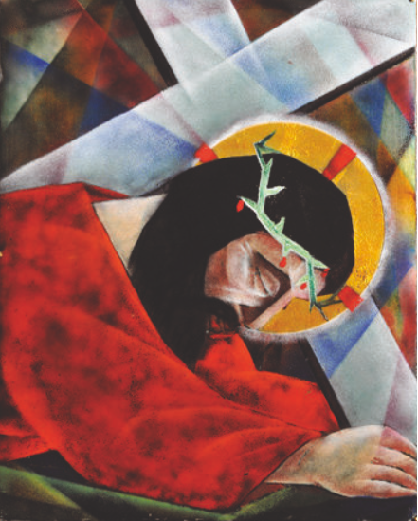
The third station
Jesus falls for the first time

Slide 4
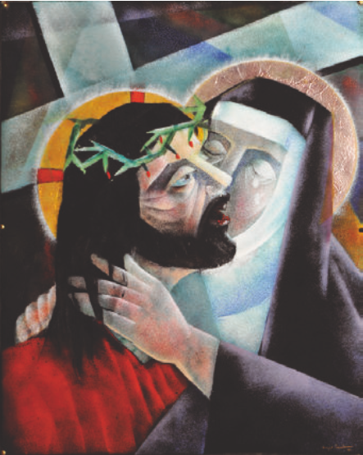
The fourth station Jesus meets his mother

Slide 5
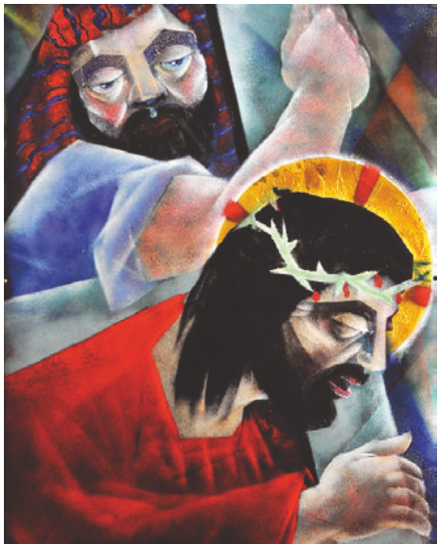
The fifth station Simon helps Jesus carry his cross

Slide 6
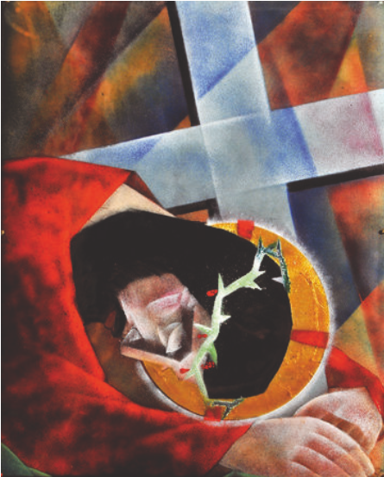
The sixth station Jesus falls a second time

Slide 7
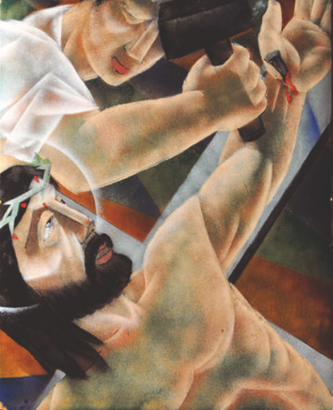
The seventh station Jesus is nailed to the cross

Slide 8
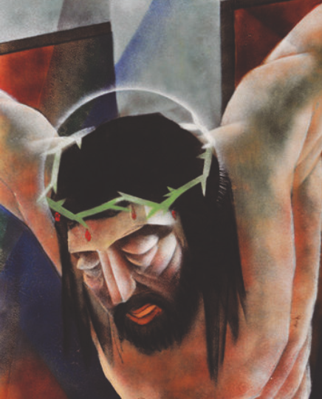
The eighth station Jesus dies on the cross

Slide 9
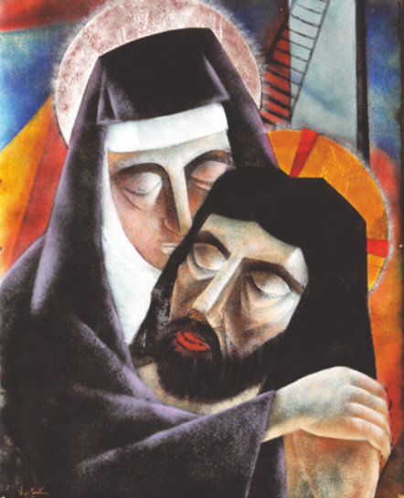
The nineth station Jesus is taken down from the cross

Slide 10
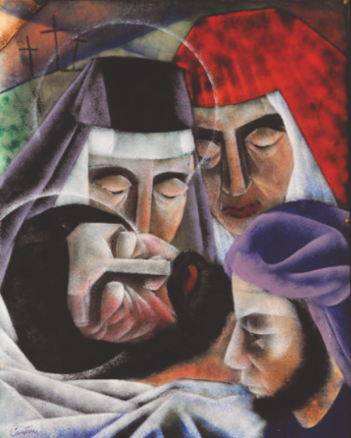
The tenth station Jesus is placed in the tomb

